Slide 1

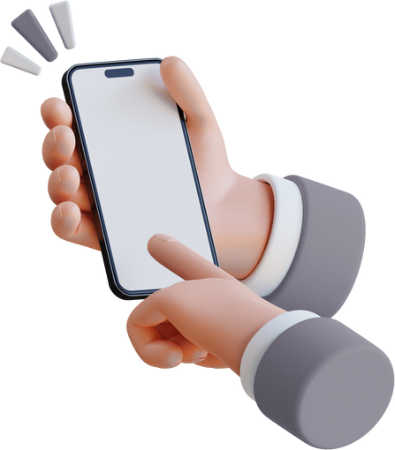
A125 - HCI
PROJECT PRESENTATION
STUBBY
Presented by Kaquilala, Leal, & Magdalan of TEAM MALEKA

Slide 2
STUBBY PROJECT
PRESENTATION CONTENT
Motivation - what problem are you addressing?
Top requirements - what did you learn from users?
Design - what does your solution look like?
Evaluation - what did you do and what were the results?
Conclusions - if you had more time, what would you do next?

Slide 3

Why: The Motivation
What problem did we want to solve?
We created Stubby to help students stay focused, organized, and connected during study sessions. Many struggle with managing tasks and motivation, especially in group work. Stubby caters mainly to group study sessions with students from the same school. It promotes collaboration, task tracking, and well-being through shared goals and gentle reminders.

Slide 4
Friendly Reminder!
"Success doesn’t come from what you do occasionally, it comes from what you do consistently."
— Marie Forleo
This quote fits perfectly with Stubby's goal! To help students build consistent study habits with the support of a focused, collaborative environment.

Slide 5
Top requirements
what did you learn from users?
During our initial user research and feedback collection, we identified key needs among online learners:
Simple and intuitive navigation to reduce cognitive load during use.
Task tracking and productivity tools to help monitor academic progress.
Collaboration features such as virtual study groups for peer interaction.
Low hardware requirements, ensuring accessibility for students with low-end devices.
Reliable notification and reminder system for deadlines and study sessions.

Slide 6
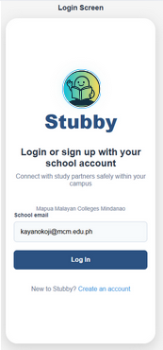
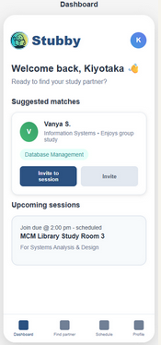
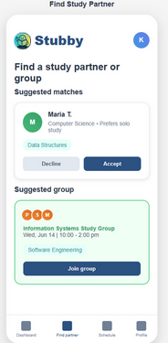
PROTOTYPE DESIGN
Log-in Screen
Dashboard
Find Study Partner

Slide 7
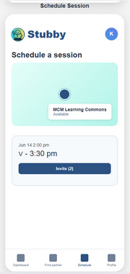
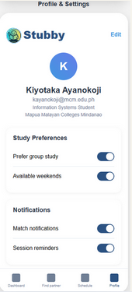
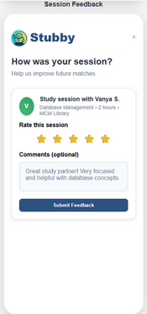
PROTOTYPE DESIGN
Schedule Session
Profile & Settings
Session Feedback

Slide 8
📌How: Identifying the Problem
To determine whether Stubby addresses actual student needs, the team conducted a quantitative evaluation using a survey method via Google Forms. The participants were asked to evaluate specific functions of the app such as profile editing, study session booking, and navigation.

Slide 9
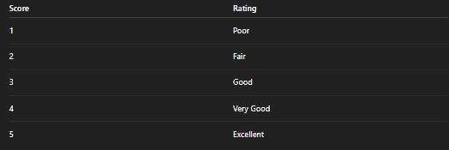
METHOD
Participants were given access to the Stubby prototype and asked to perform key tasks (e.g., editing their profile, viewing match suggestions, scheduling sessions). After completing these tasks, they responded to a Likert-scale-based survey alongside open feedback questions.
The 5-point Likert scale used was:

Slide 10
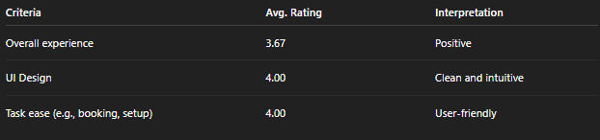
General User Experience:

Slide 11
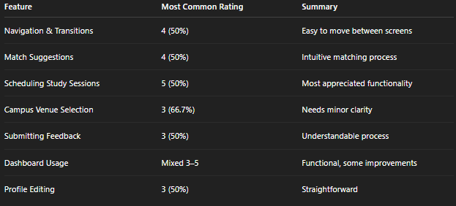
Feature Evaluation Breakdown:

Slide 12
💬PARTICIPANT FEEDBACK
What worked best?
Confusions or issues?
“Everything”
“Scheduling a study session”
“It helps me be organized”
“Navigation”
Mostly none
One participant noted minor lag
Suggested improvements:
Notification system
Assist bot
More scheduling flexibility

Slide 13
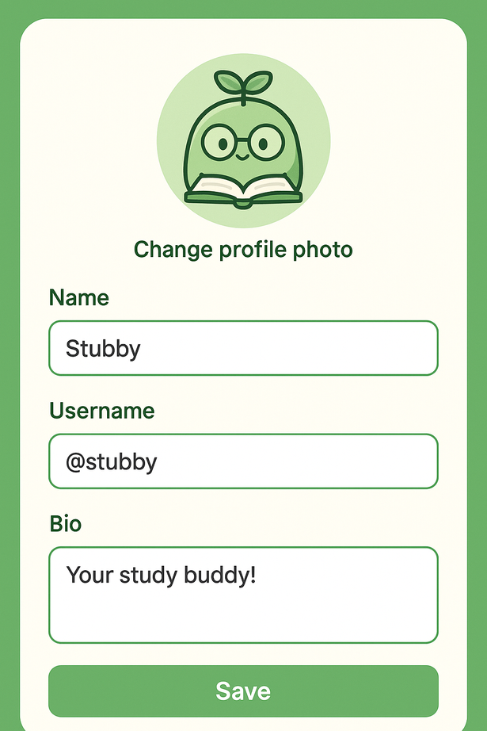
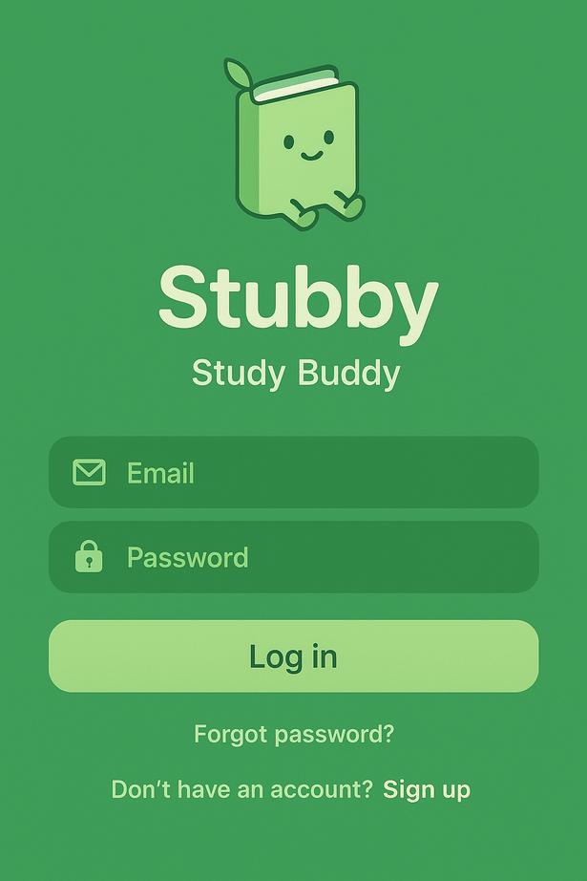
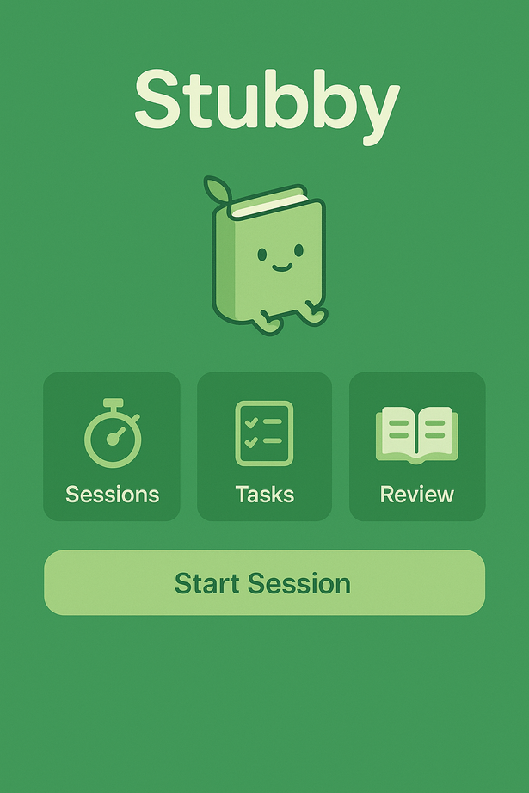
Features not implemented:

Slide 14
CONCLUSION:
What We Learned:
Users appreciated the app’s simplicity and its clear focus on supporting their academic routines.
Real-time features and deeper collaboration options are highly valued and expected.
Network constraints in the Philippines impacted testing and highlight the importance of offline functionality.
If given more time and resources, we would:
Implement the virtual study session feature, allowing synchronous peer learning.
Enhance backend functionality, including real-time chat, notifications, and user profiles.
Conduct two-phase evaluations, comparing the initial and revised prototypes.
Optimize for unstable internet environments, including offline mode and data sync features.

Slide 15
Final Remarks:
Stubby the Study Buddy represents our solution to the evolving challenges of online learning. It’s built with accessibility, collaboration, and productivity in mind. This project allowed us to understand how thoughtful design, user feedback, and iterative development work together in building effective digital tools. We’re proud of our progress and excited about the potential Stubby has in supporting students during remote and hybrid learning.

Slide 16

TEAM MALEKA MEMBERS
ANGELINE KAQUILALA
CEDRIC JOSH LEAL
SHELLEY MAGDALAN

Slide 17
Thank You
End of Presentation

